Slide 1
Open Research Across Borders

Slide 2
Challenges
Open research needs:
  To be able to find interesting data,
  Move the data to convenient locations,
  Process the data and publish the findings
Can we securely share sensitive data to:
  Pool expertise to address common problems
Try to make use of existing EOSC services and identify missing services.
Community engagement in Nordic and Baltic big computing users: Climate, Natural Language Processing, Biodiversity.

Slide 3
Making Research Data findable
Use case: Making archeological data (Danish Fund og Fortidsminder) discoverable through B2FIND
  Harvesting and displaying metadata for archeological sites and findings
Showcase: http://b2find.eudat.eu/dataset?groups=slks
Assessment of scientific value
  What data is this, is it useful, who will use it?
  Assistance from external experts
  How FAIR is this data? Using FAIR evaluator tool
  Possible adjustments to harvesting strategy
Plans to extend with other Nordic archeological data and possibly other repositories (national and/or discipline specific)
  Vision for Nordic archeological data infrastructure

Slide 4
Cross-border computing
Describe the packaging for NLPL and what it solves
Describe the problem with portals and HPC and the efforts with Puhuri to address these problems
Describe collaboration between EOSC-life and EOSC-Nordic on Galaxy use

Slide 5
Managing Data
Cover data management plans, cross-border data access and workflow management.

Slide 6
Storage 1
Comp
Comp
Orchestrator
Storage 2
Expt
Expt
Expt
Expt
Notes:
Elements on the right represent existing (FAIR) climate data sources: climate model output and measurements of climate related variables. Aim of the climate use case is to use existing technology (one being Galaxy) to facilitate the combination, evaluation, processing of existing data sources to gain new scientific insight.
Challenges:
Climate model output: (very) large volume. Outside of the large international modeling projects (CMIP, CORDEX), climate model output is commonly not FAIR.
Measurements of climate related variables: Held in widely dispersed databases, not easily findable.
It is common for researchers to use ad hoc solutions to the problem of processing climate data ie. these workflows are not (easily) reproducible, sharable or FAIR.

Slide 7
Country D
Country A
Storage 1
Comp
Country D
AAI?
Policy?
Access?
Country C
Comp
Discovery?
Orchestrator
Deployment?
Monitoring?
Country E
Country B
Workflows?
Reproducibility?
Storage 2
Expt
Expt
Data Management Plan
Expt
Expt

Slide 8
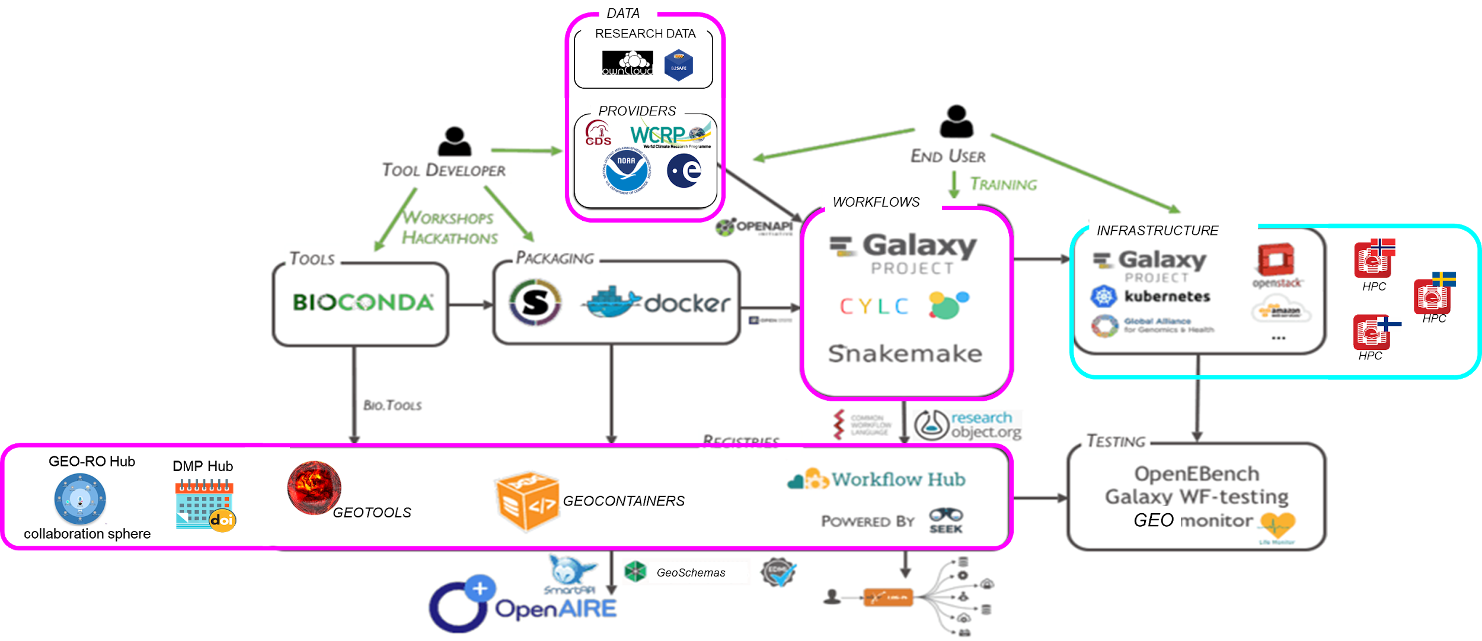
Orchestrator

Slide 9
Where are we?
Have tested portal in Germany accessing data in Norway running jobs in Germany. Will next test access to data in Finland, Norway from Germany.
Investigating the Workflow issue
  Common, abstract language necessary that can be instantiated as Galaxy etc workflows.
  PID for workflows and reference in Data management Plan (DMP).
DMPs need to be ‘FAIR’
  Working on development of a template that helps researchers produce FAIR data.
DMPs need to be machine-actionable (we want to maybe replay a workflow, deploy a service, make sure we can use these services, etc).
  Have been contributing to the Research Data Alliance machine actionable DMP working group.
  First version of DMP tool with rudimentary support for maDMP application profile. Next connect this to one or more services.

Slide 10
Sensitive Data across borders
What are the use-cases, what are the approaches to accomplish these use-cases. Collaboration with NEIC projects (pari). What from EOSC-Nordic would be useful there?

