Slide 1
Breaking the glass wall: delivering Nordic and Baltic research services across the border
Ilja Livenson, EOSC-Nordic Open Symposium
25 September 2020

Slide 3
Nordic/Baltic region is a
small region of relatively
similar countries.
Can we make EOSC work?
By Taller345 - Own work, CC BY-SA 4.0, https://commons.wikimedia.org/w/index.php?curid=63245736
Notes:
Original hypothesis – can we make eosc work faster in the Nordics?

Slide 4
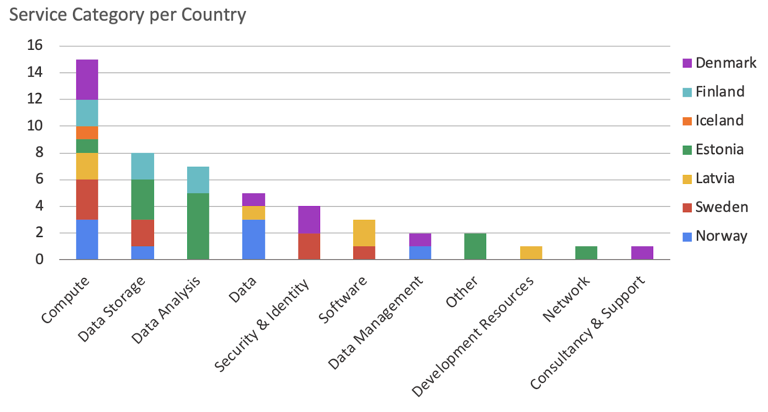
Results of the first round of service discovery
Notes:
We can “see” the services, can we actually use them?

Slide 5
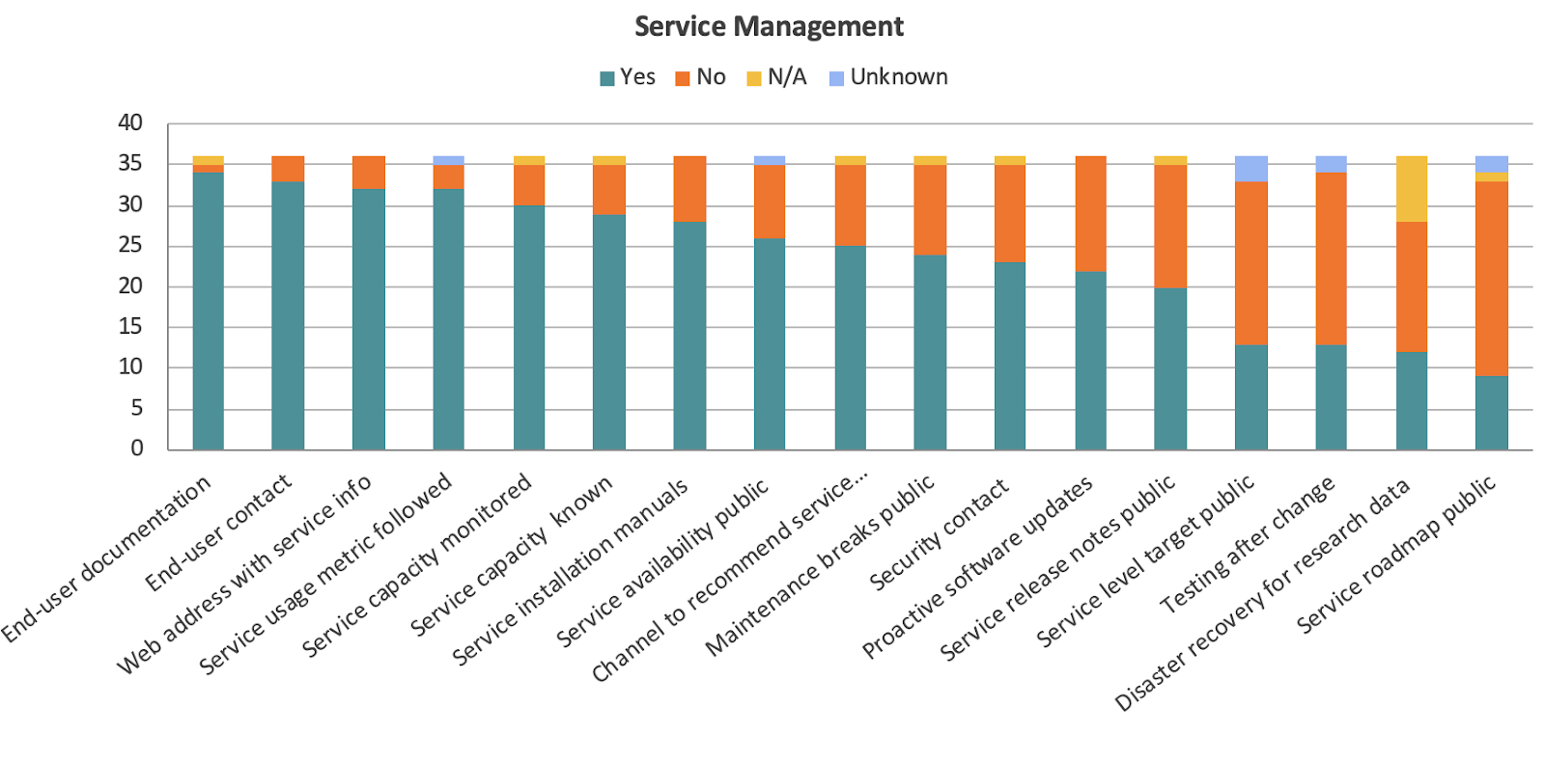
Service management from EOSC perspective

Slide 6
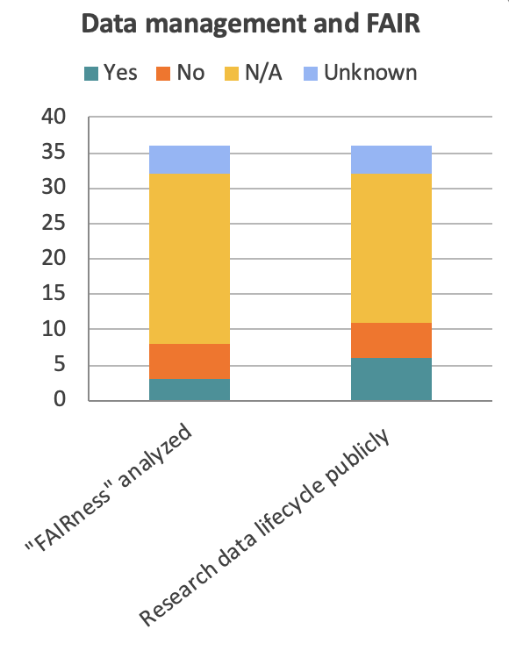
How much are services aware of FAIR?

Slide 7
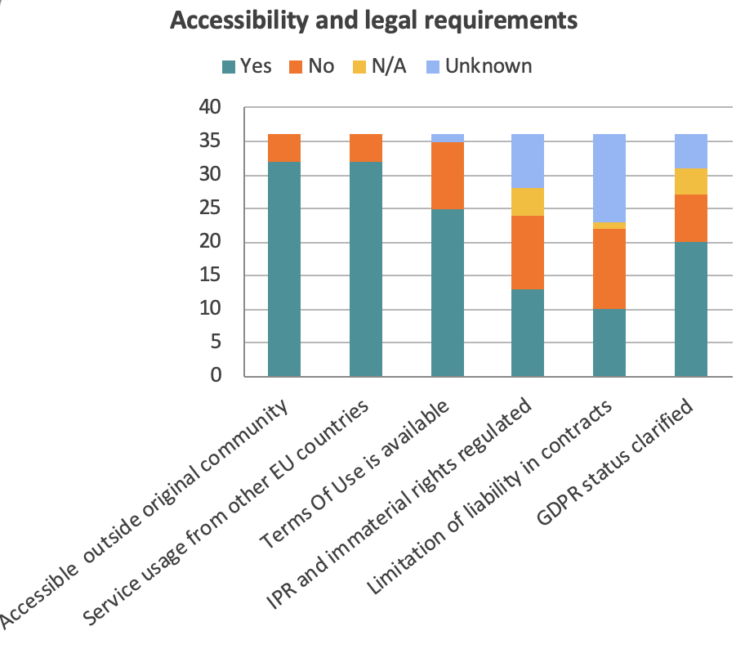
Access and legal aspects of services differ

Slide 8
“So how can I access the service?”
EU research community manager

Slide 9
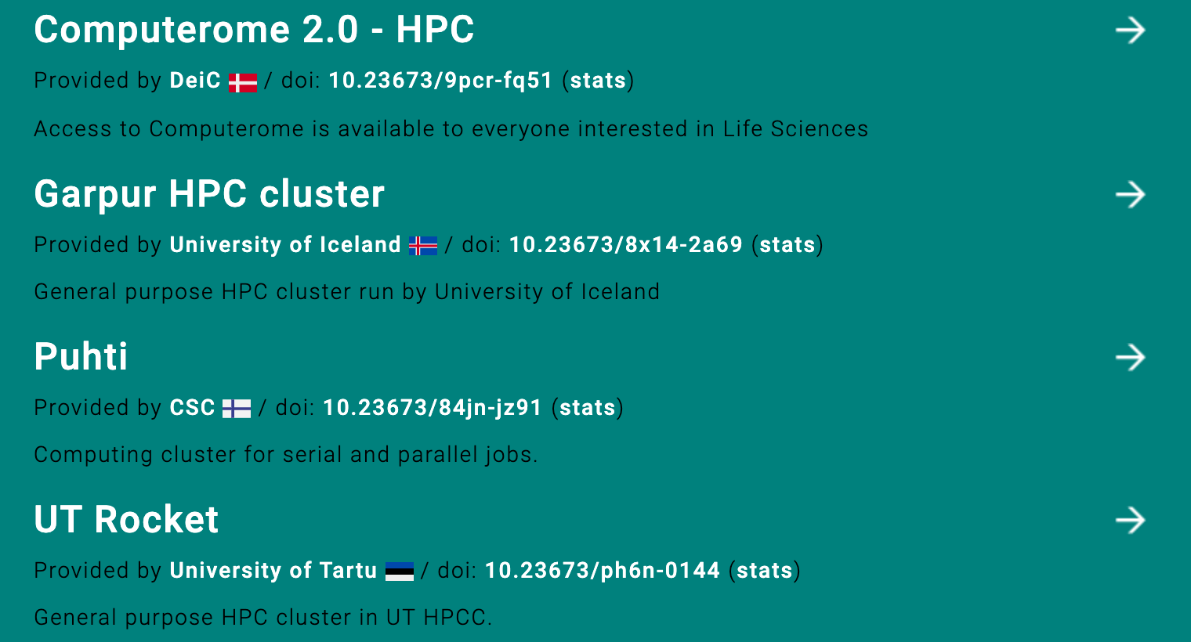
For example, each country has an HPC service
Notes:
If you go tomorrow to one of such services, you will find out it is not so easy to qualify

Slide 10
Crucial components for providing services across the border
Motivation
Ability
Legal / mandate
Compensation
Sustainability
Procedures
How can we achieve it?

Slide 11
LUMI model
LUMI is a pan-European pre-exascale supercomputer, part of EuroHPC
LUMI countries are Finland, Belgium, Czech Republic, Denmark, Estonia, Iceland, Norway, Poland, Sweden, and Switzerland.
Co-funding model where consortium members agree on common principles of service offering and delivery.
Motivation: pooling of resources
Benefit: strong motivation for using the co-funded service

Slide 12
EOSC Service model
EOSC Service complies with EOSC Rules of Participation.
EOSC Service follows EOSC Architecture.
Motivation: EOSC Sustainability model
Benefit: Scalable

Slide 13





Resource provider
Resource provider
Resource provider
Resource provider
Resource provider
Legal
Interoperability
Agreements
Organisational
Interoperability
Agreements
Semantic
Interoperability
Ontologies, Crosswalks
Technical
Interoperability
API, Standards
Notes:
European Interoperability Framework / EOSC Interoperability framework

Slide 14

For EOSC to succeed we need to break the walls

